Slide 1
Chapter 17
Options on Stock Indices and Currencies

Slide 2
Index Options)
The most popular underlying indices in the U.S. are
  The S&P 100 Index (OEX and XEO)
  The S&P 500 Index (SPX)
  The Dow Jones Index times 0.01 (DJX)
  The Nasdaq 100 Index (NDX)
Exchange-traded contracts are on 100 times index; they are settled in cash; OEX is American; the XEO and all others are European

Slide 3
Index Option Example
Consider a call option on an index with a strike price of 880
Suppose 1 contract is exercised when the index level is 900
What is the payoff?

Slide 4
Using Index Options for Portfolio Insurance
Suppose the value of the index is S₀ and the strike price is K
If a portfolio has a β of 1.0, the portfolio insurance is obtained by buying 1 put option contract on the index for each 100S₀ dollars held
If the β is not 1.0, the portfolio manager buys β put options for each 100S₀ dollars held
In both cases, K is chosen to give the appropriate insurance level

Slide 5
Example 1
Portfolio has a beta of 1.0
It is currently worth $500,000
The index currently stands at 1000
What trade is necessary to provide insurance against the portfolio value falling below $450,000?

Slide 6
Example 2
Portfolio has a beta of 2.0
It is currently worth $500,000 and index stands at 1000
The risk-free rate is 12% per annum
The dividend yield on both the portfolio and the index is 4%
How many put option contracts should be purchased for portfolio insurance?

Slide 7
Calculating Relation Between Index Level and Portfolio Value in 3 months (Table 17.1)
If index rises to 1040, it provides a 40/1000 or 4% return in 3 months
Total return (incl. dividends) = 5%
Excess return over risk-free rate = 2%
Excess return for portfolio = 4%
Increase in Portfolio Value = 4+3−1=6%
Portfolio value=$530,000

Slide 8
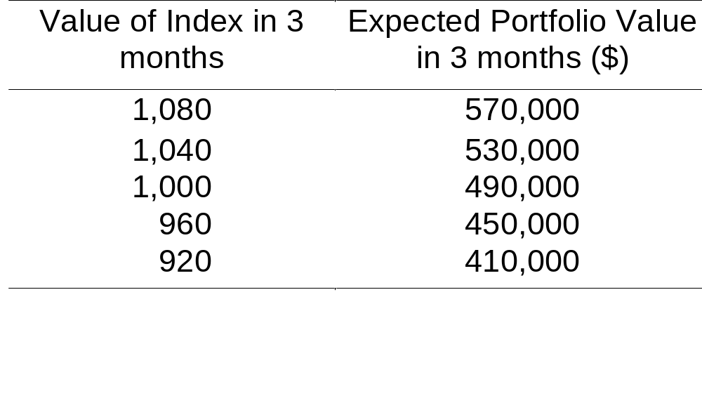
Determining the Strike Price (Table 17.2,)
An option with a strike price of 960 will provide protection against a 10% decline in the portfolio value

Slide 9
Currency Options
Currency options trade on NASDAQ OMX
There also exists a very active over-the-counter (OTC) market
Currency options are used by corporations to buy insurance when they have an FX exposure

Slide 10
Range Forward Contracts
Have the effect of ensuring that the exchange rate paid or received will lie within a certain range
When currency is to be paid it involves selling a put with strike K₁ and buying a call with strike K₂ (with K₂ > K₁)
When currency is to be received it involves buying a put with strike K₁ and selling a call with strike K₂
Normally the price of the put equals the price of the call

Slide 11
Range Forward Contract continued Figure 17.1, page 368
Payoff
Payoff
Asset Price
K₁
K₂
K₁
K₂
Asset Price
Short Position
Long Position

Slide 12
European Options on Assets
Providing a Known Yield
We get the same probability distribution for the asset price at time T in each of the following cases:
1. The asset starts at price S₀ and provides a yield = q
2. The asset starts at price S₀e^{–qT} and provides no income

Slide 13
European Options on Assets
Providing Known Yield continued
We can value European options by reducing the asset price to S₀e^{–qT} and then behaving as though there is no income

Slide 14
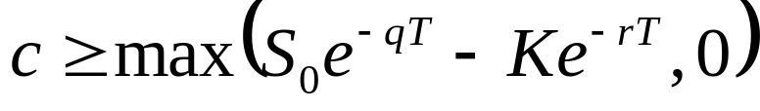
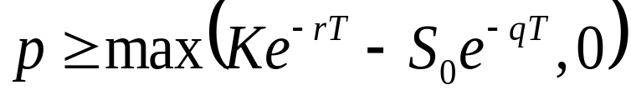
Extension of Chapter 11 Results
(Equations 17.1 to 17.3)
Lower Bound for calls:
Lower Bound for puts
Put Call Parity

Slide 15
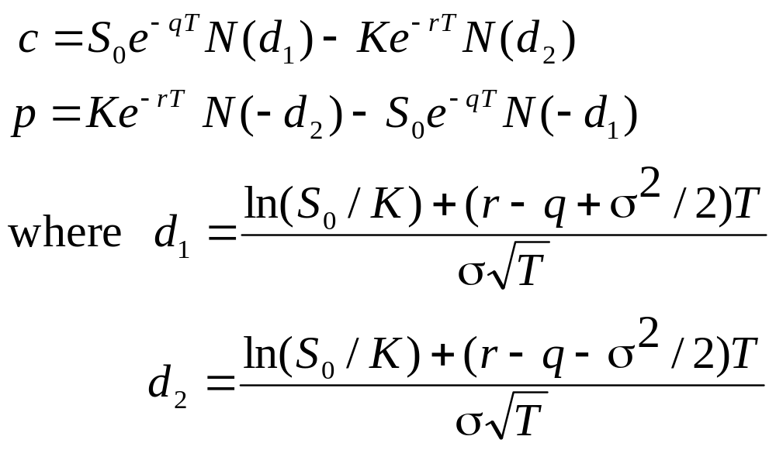
Extension of Chapter 15 Results (Equations 17.4 and 17.5)

Slide 16
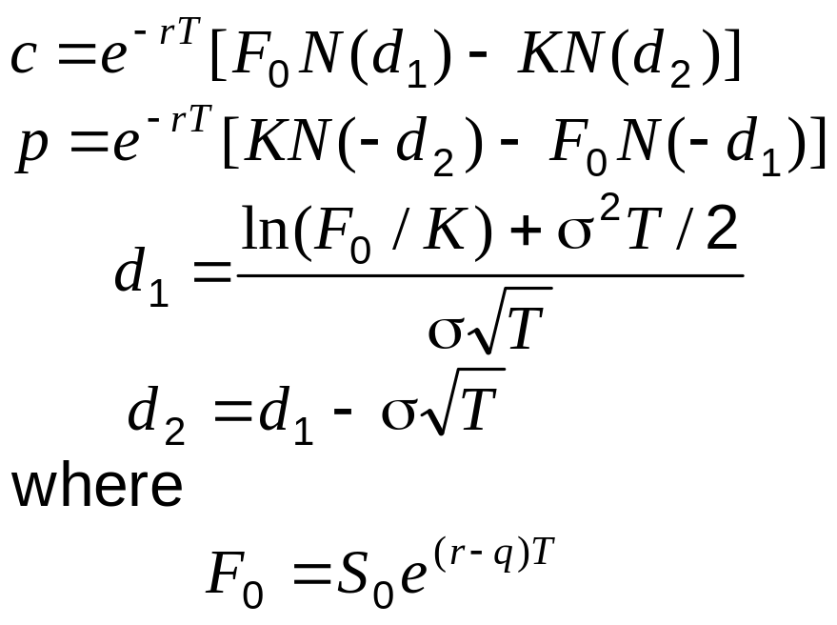
Alternative Formulas (equations 17.8 and 17.9)

Slide 17
Valuing European Index Options
We can use these formulas for an option on an asset paying a dividend yield
Set S₀ = current index level
Set F₀= futures or forward index price for a contract maturing at the same time as the option
Set q = average dividend yield expected during the life of the option

Slide 18
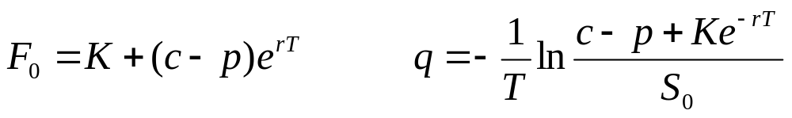
Implied Forward Prices and Dividend Yields (equation (17.10)
From European calls and puts with the same strike price and time to maturity
These formulas allow term structures of forward prices and dividend yields to be estimated
OTC European options are typically valued using the forward prices (Estimates of q are not then required)
American options require the dividend yield term structure

Slide 19
Valuing European Currency Options
A foreign currency is an asset that provides a yield equal to r_{f}
We can use the formula for an option on a stock paying a dividend yield :
  S₀ = current exchange rate
  q = r_{ƒ}

Slide 20
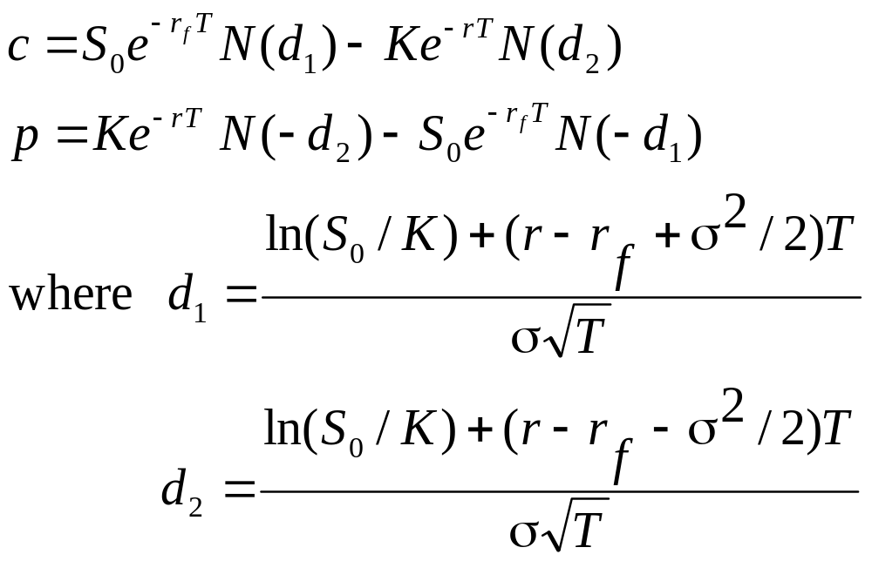
Formulas for European Currency Options (Equations 17.11 and 17.12)

Slide 21
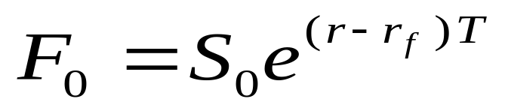
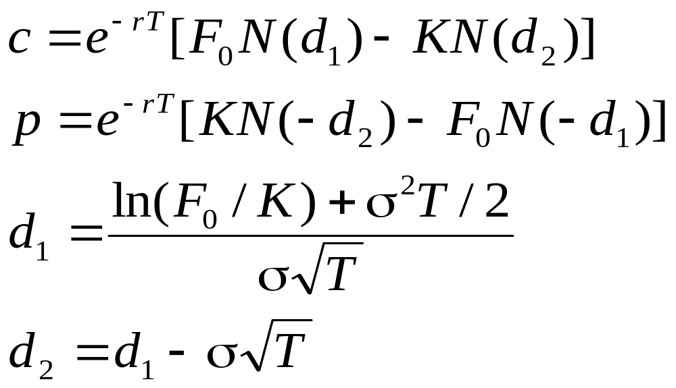
Alternative Formulas (Equations 17.13 and 17.14)
Using

Slide 22
The Binomial Model
S₀u
ƒ_{u}
p
S₀
ƒ
S₀d
ƒ_{d}
(1 – p )
        f=e^{-rT}[pf_{u}+(1−p)f_{d} ]

Slide 23
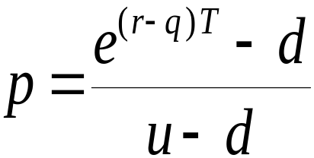
The Binomial Model continued
In a risk-neutral world the asset price grows at r−q rather than at r when there is a dividend yield at rate q
The probability, p, of an up movement must therefore satisfy
pS₀u+(1−p)S₀d = S₀e ^{(r−q)T}
so that

Slide 24
The Binomial Model continued
In the case of an option on a stock index we set q equal to the dividend yield on the index
In the case of a currency we set q equal to the foreign risk-free rate

